Slide 1


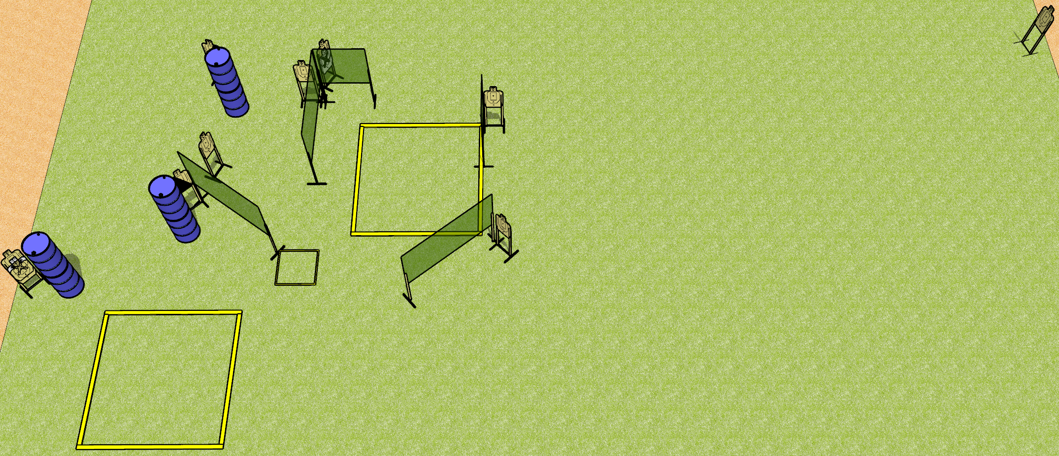
 | Dothan Gun Club – USPSA Match Hop Around Course Designer : Drew Coleman
Round Count 20 rounds 10 USPSA
Equipment List 9 wall feet 1 shooting box 1 left and 1 right diag Use 10’ fault lines for other boxes

Slide 2
Hop Around
Written Stage Briefing
Hop Around is a 20 round, 100 point, Comstock course of fire. There are 10 USPSA targets. The best 2 hits on paper will score. The start signal is audible.
Handgun start position is in the middle shooting area, wrists below belt. Handgun is loaded and holstered.
PCC start position is in the middle shooting area, stock on belt. Loaded carbine is held with both hands, safety on.
On start signal, engage targets as they become available from within the shooting areas.

